Slide 1
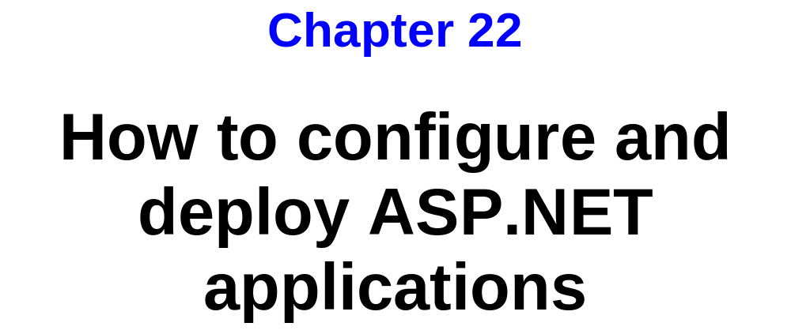
Murach’s ASP.NET 4/C#, C22
© 2011, Mike Murach & Associates, Inc.
Slide <number>

Slide 2
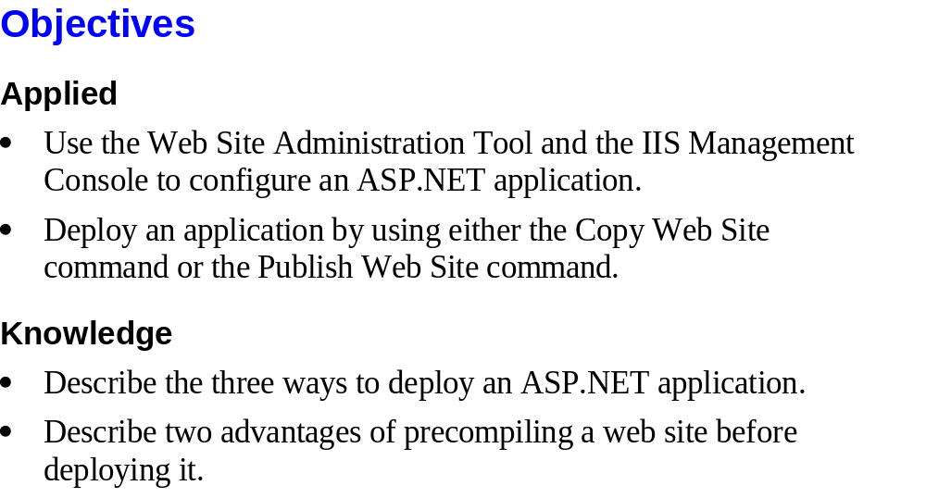
Murach’s ASP.NET 4/C#, C22
© 2011, Mike Murach & Associates, Inc.
Slide <number>

Slide 3

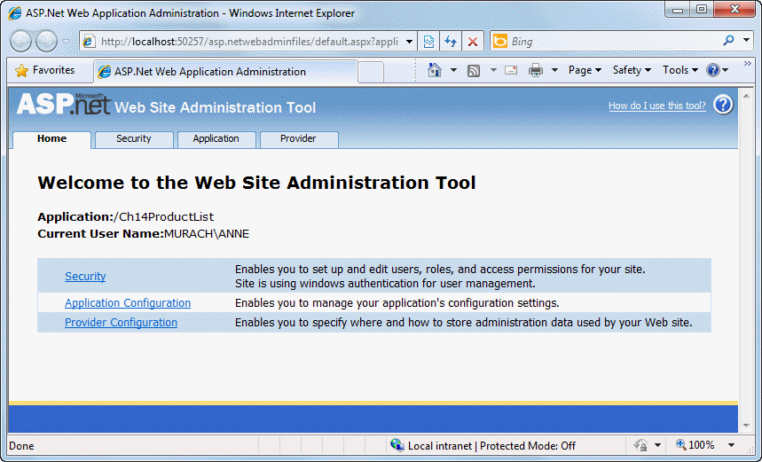
Murach’s ASP.NET 4/C#, C22
© 2011, Mike Murach & Associates, Inc.
Slide <number>

Slide 4
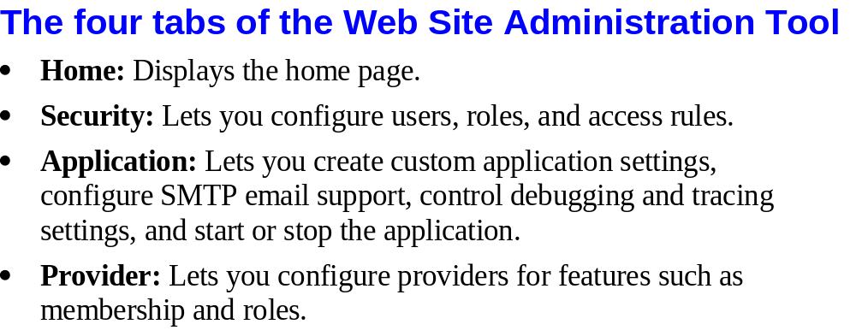
Murach’s ASP.NET 4/C#, C22
© 2011, Mike Murach & Associates, Inc.
Slide <number>

Slide 5

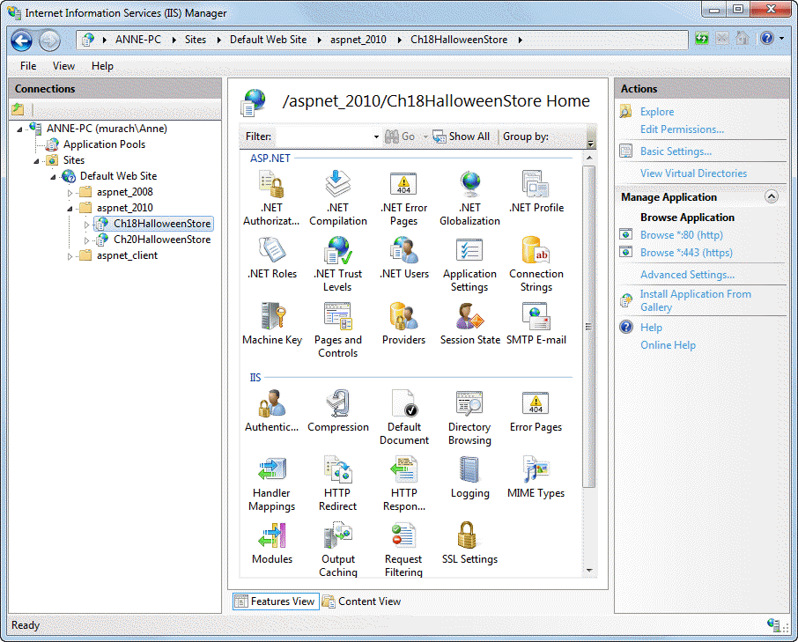
Murach’s ASP.NET 4/C#, C22
© 2011, Mike Murach & Associates, Inc.
Slide <number>

Slide 6

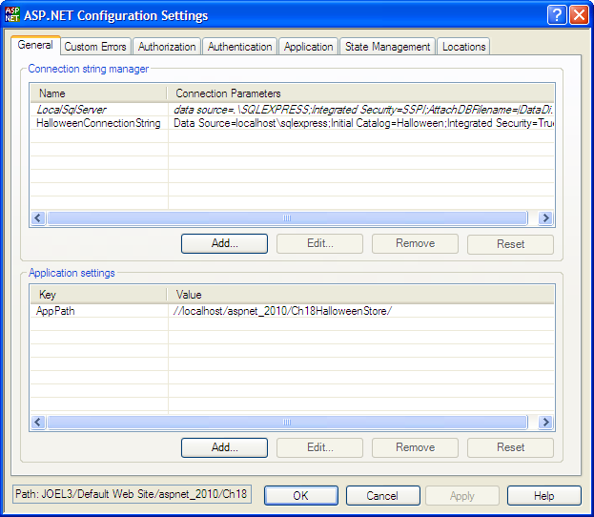
Murach’s ASP.NET 4/C#, C22
© 2011, Mike Murach & Associates, Inc.
Slide <number>

Slide 7
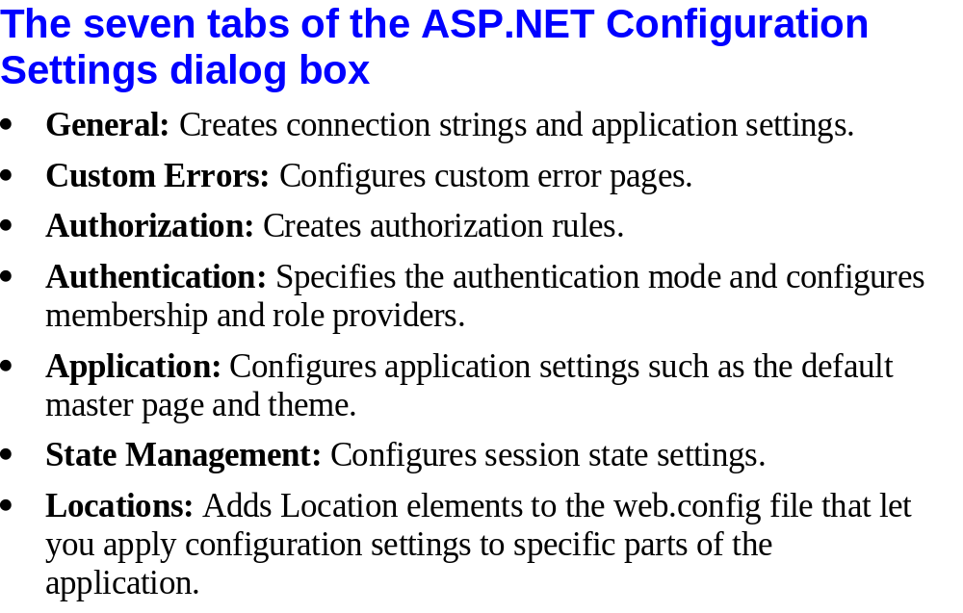
Murach’s ASP.NET 4/C#, C22
© 2011, Mike Murach & Associates, Inc.
Slide <number>

Slide 8
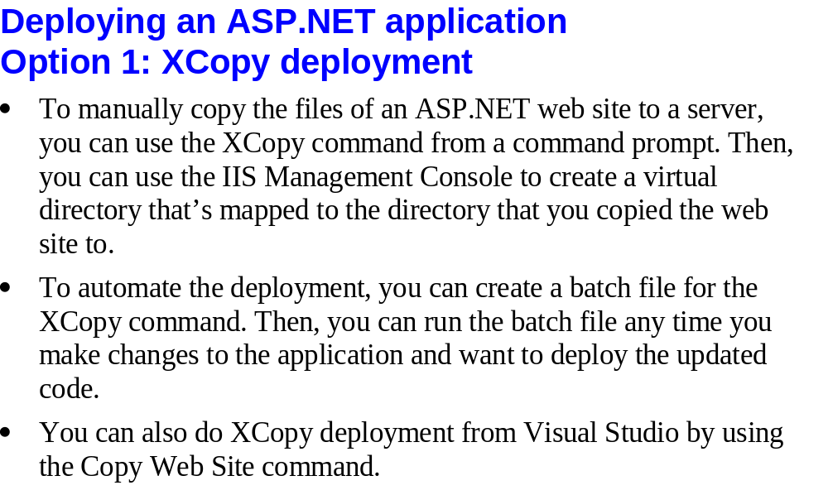
Murach’s ASP.NET 4/C#, C22
© 2011, Mike Murach & Associates, Inc.
Slide <number>

Slide 9
Deploying an ASP.NET application
Option 2: Using One-Click Publish in Visual Studio
Refer to http://msdn.microsoft.com/en-us/library/dd465337(v=vs.110).aspx
Slide <number>

Slide 10
Deploying an ASP.NET application
Option 3: Create a Web Deployment Package in Visual Studio
Refer to: http://msdn.microsoft.com/en-us/library/dd465323(v=vs.110).aspx
Slide <number>

Slide 11
Addition References on Web Deployment
Web Deployment Overview for Visual Studio and ASP.NET
  http://msdn.microsoft.com/en-us/library/dd394698(v=vs.110).aspx
Web Deployment Content Map for Visual Studio and ASP.NET
  http://www.asp.net/whitepapers/aspnet-web-deployment-content-map#databaseseparate
Slide <number>

